Slide 1

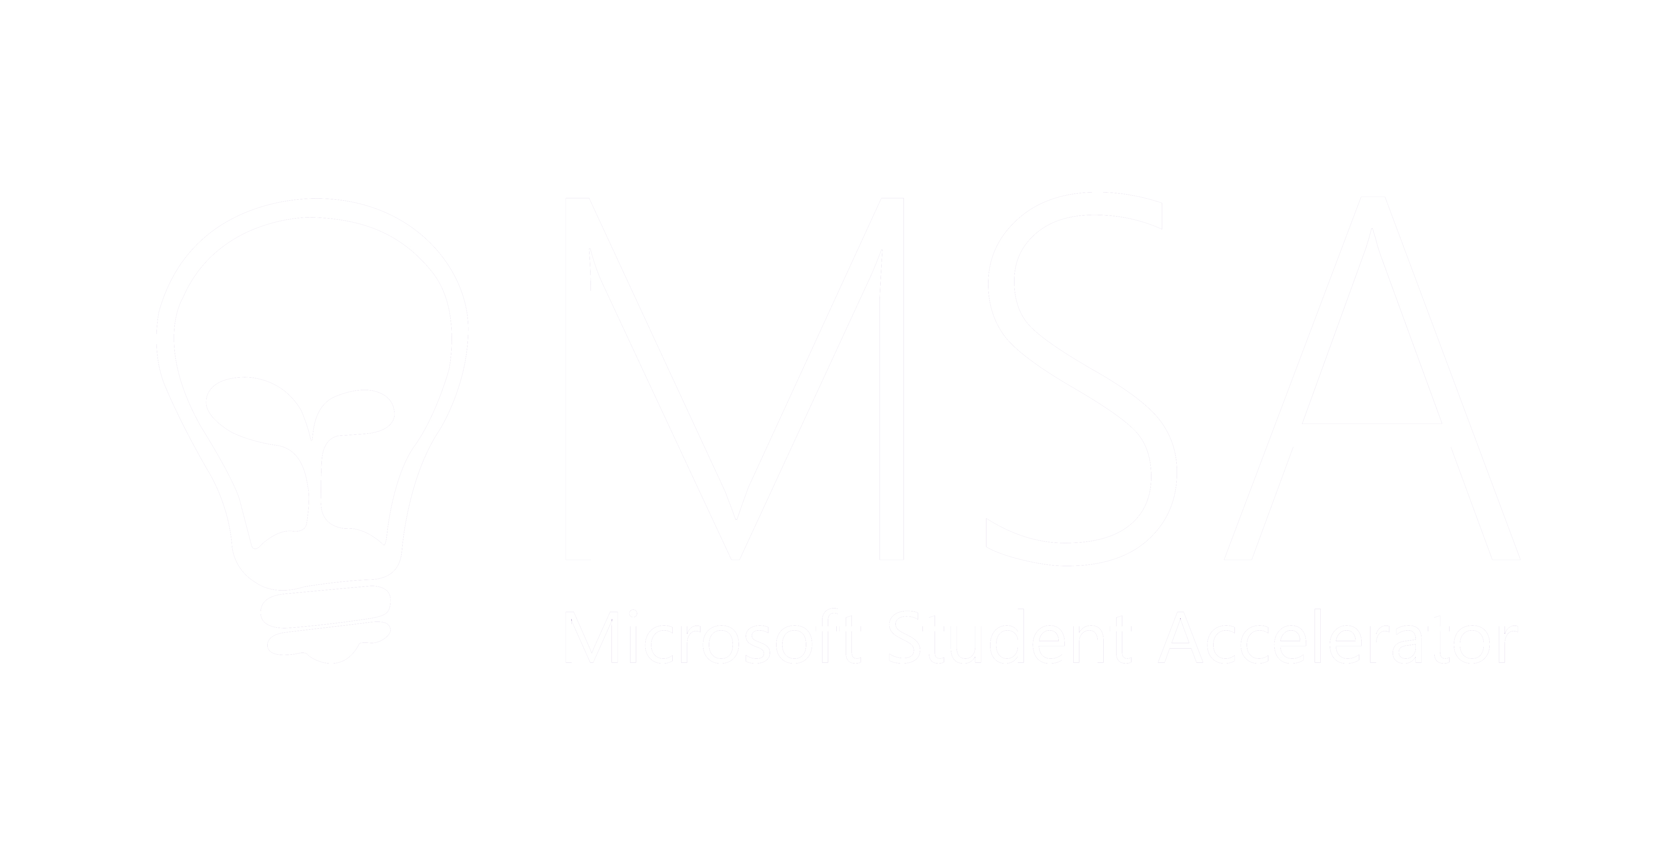
Artificial Intelligence and Machine Learning

Slide 2
1000kg
40mpg
3000kg
20mpg
?
2000kg

Slide 3
inputs
output
1000kg
40mpg
3000kg
20mpg
2000kg
30mpg

Slide 6
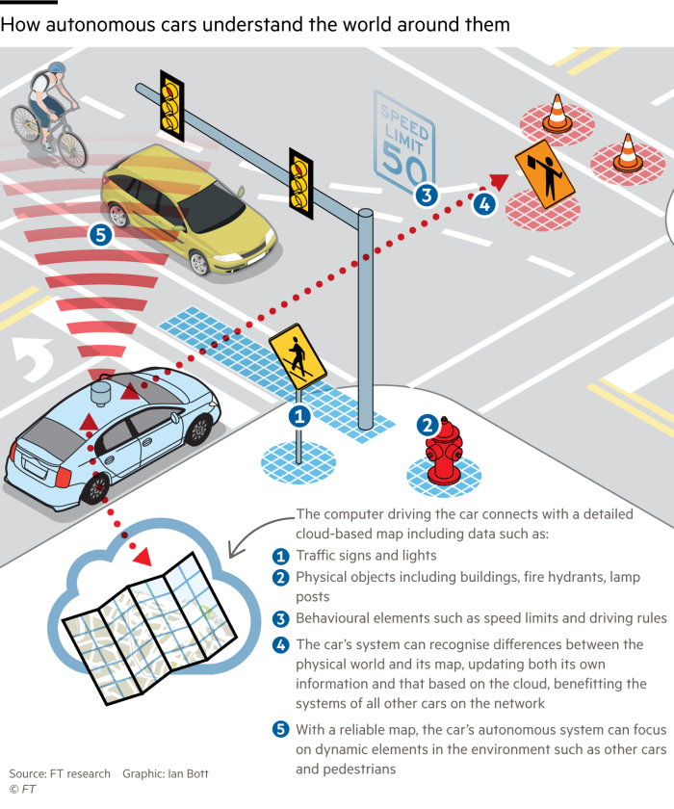
AI Example

Slide 7
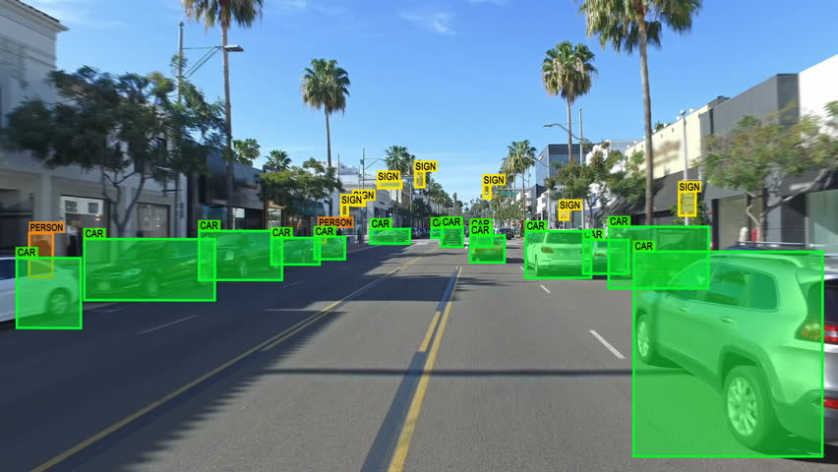
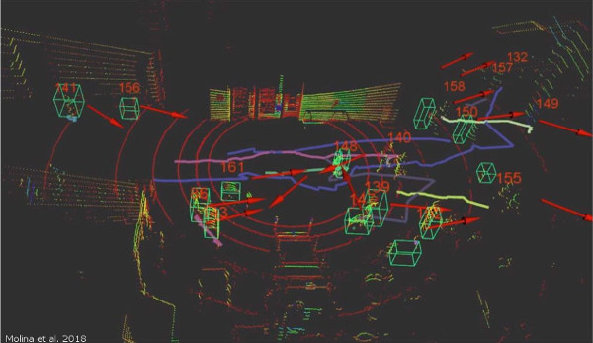
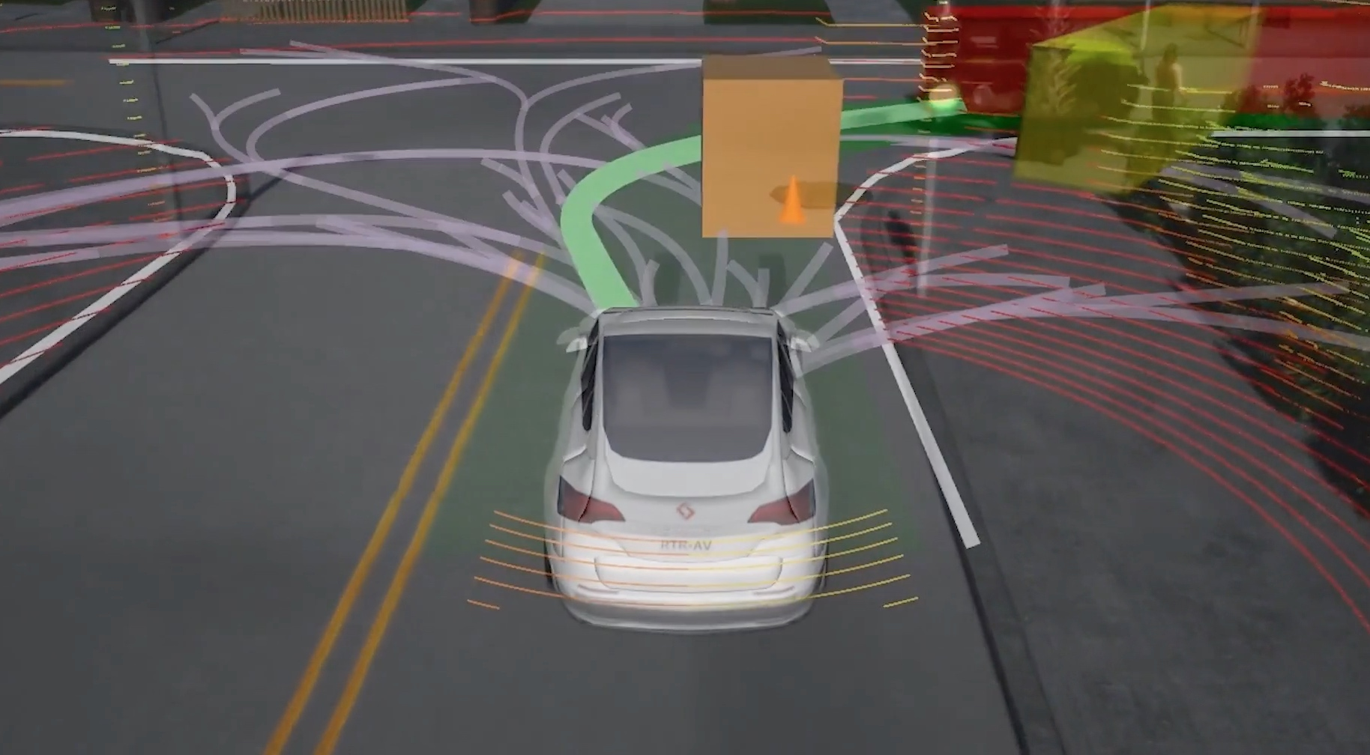
Perception Prediction Planning

Slide 8
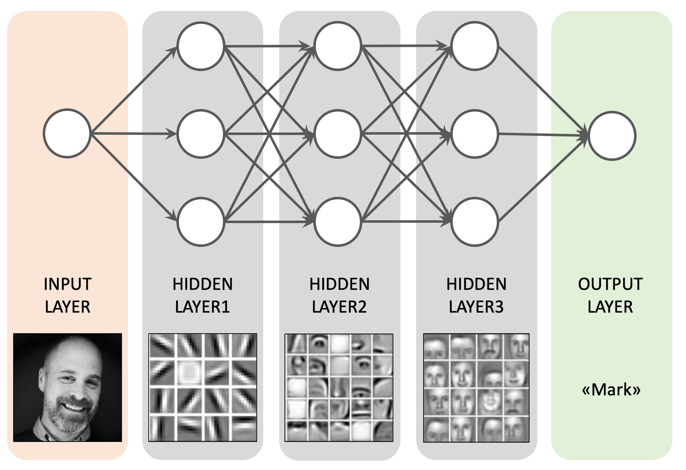
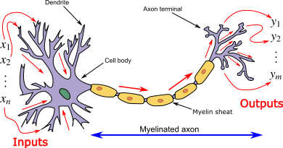
Deep Learning / Neural Networks

Slide 9
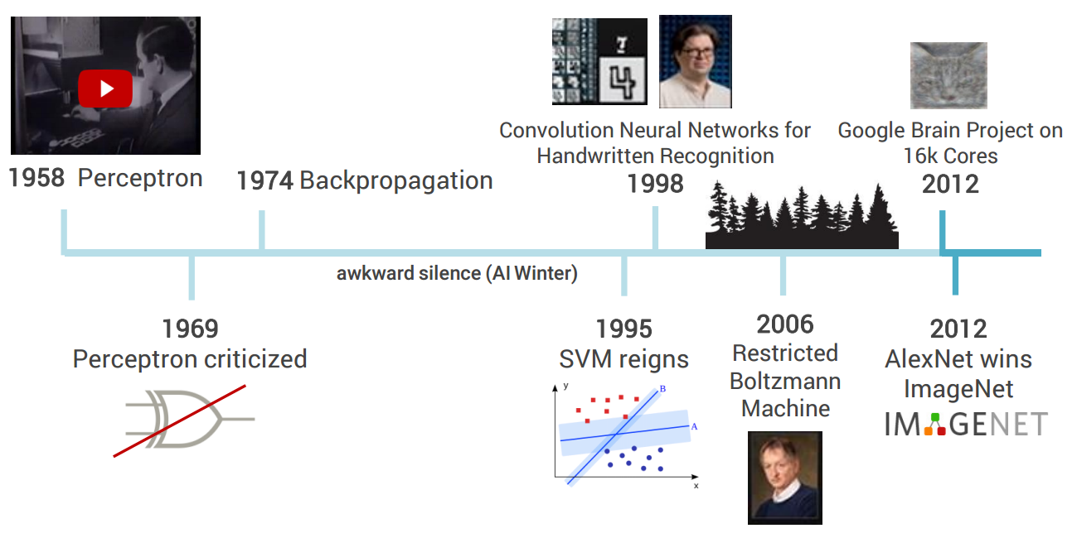
Deep Learning

Slide 10


Slide 11
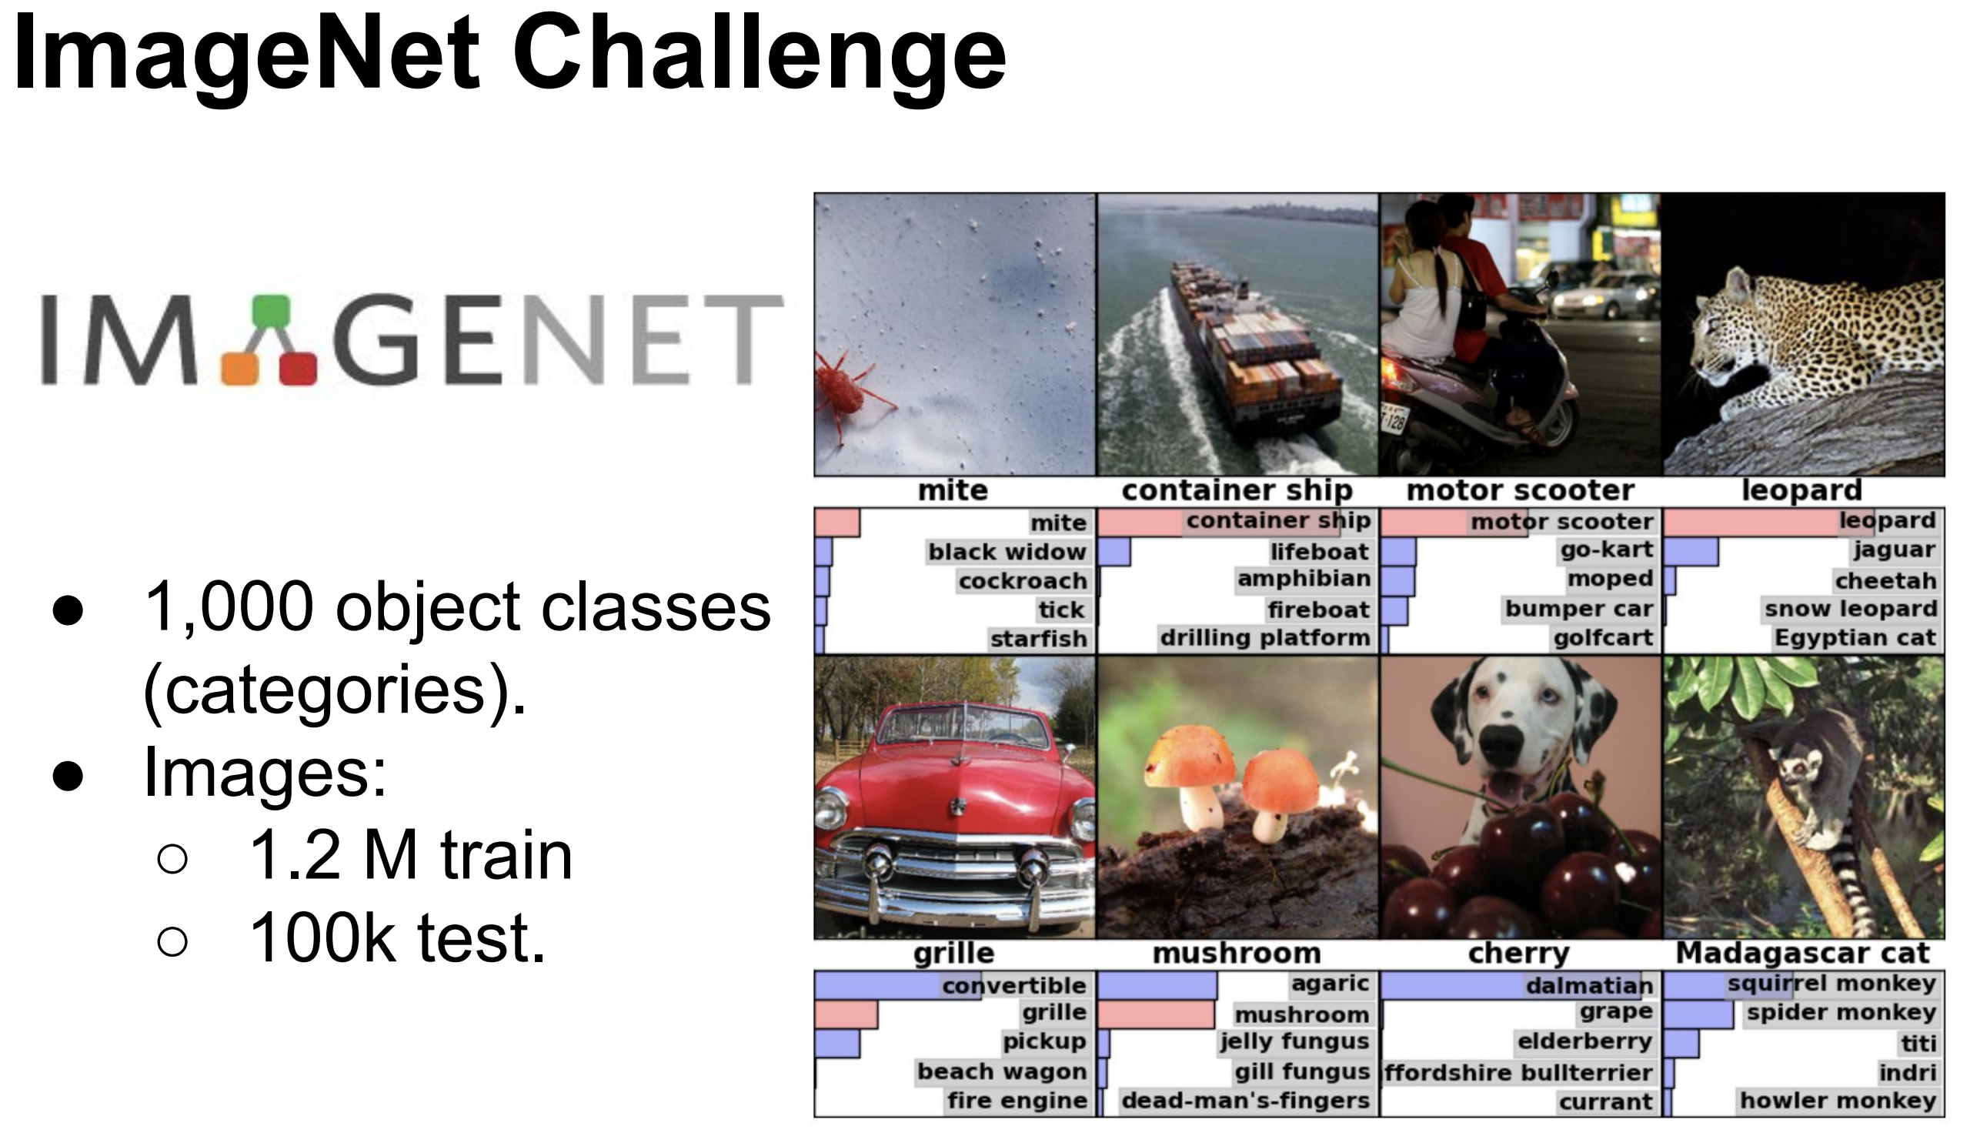
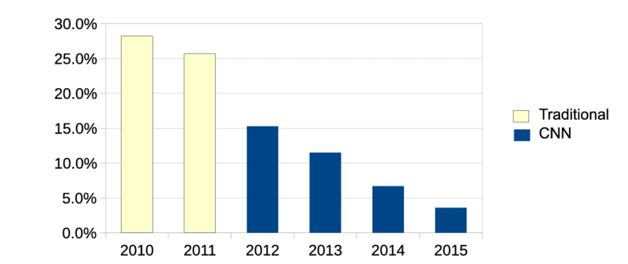
Imagenet

Slide 12

Neural Networks

Slide 13
Notes:
https://openai.com/blog/musenet/
https://openai.com/blog/better-language-models/

Slide 14

Convolutional Neural Network

Slide 15
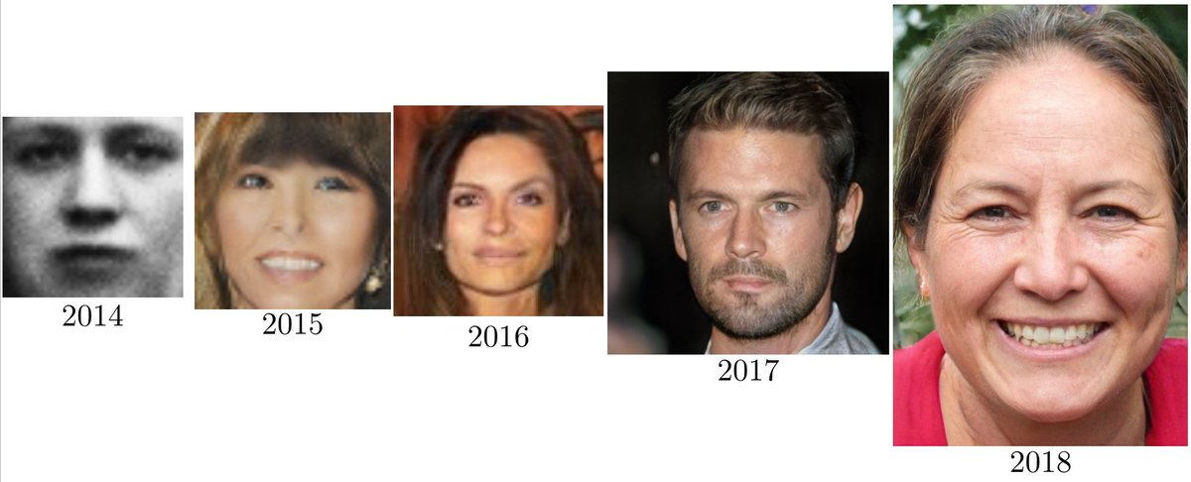

Slide 16
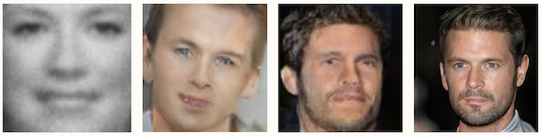

Slide 18
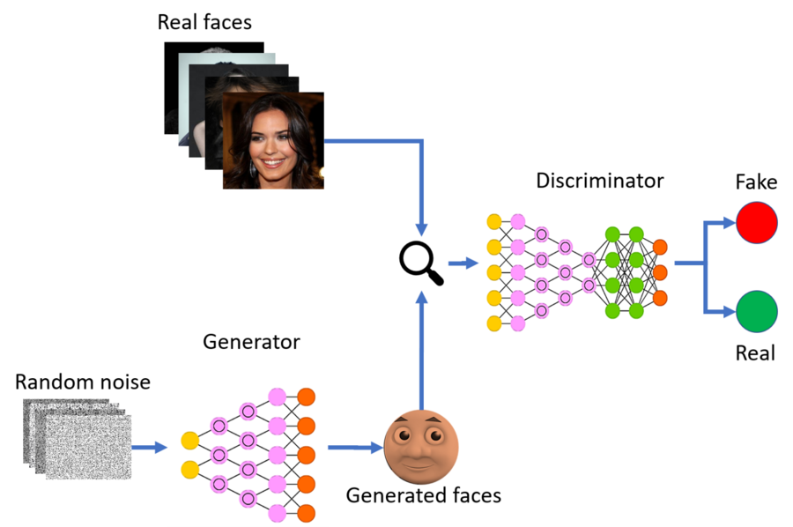
GANs (Generative Adversarial Networks)

Slide 19
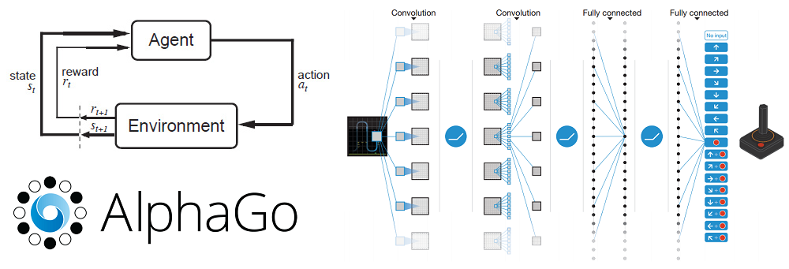
Deep Reinforcement Learning

Slide 20
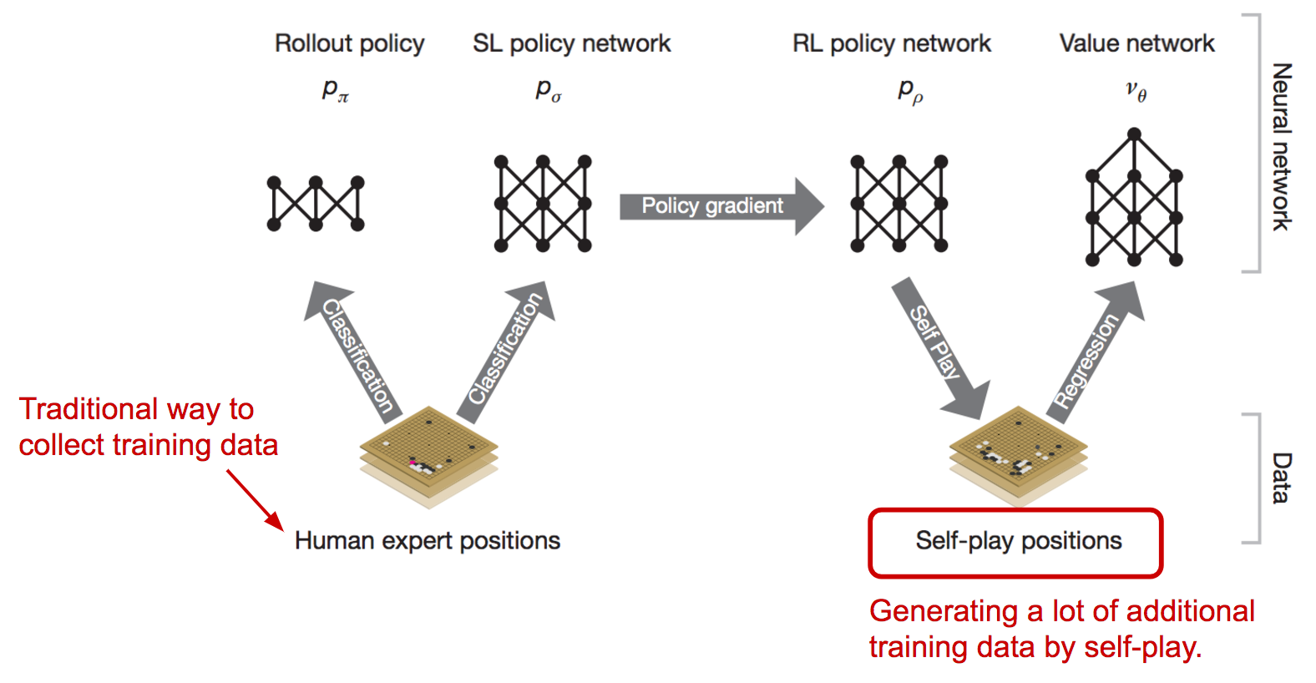
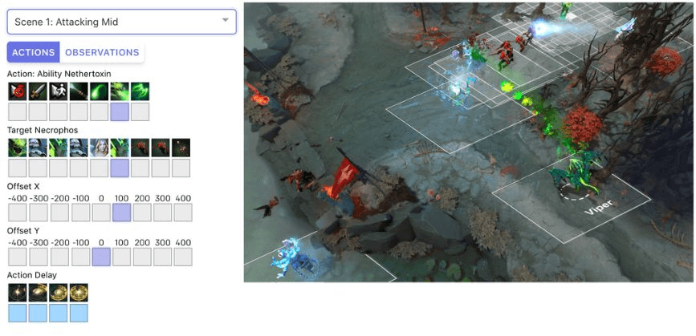
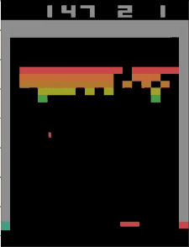
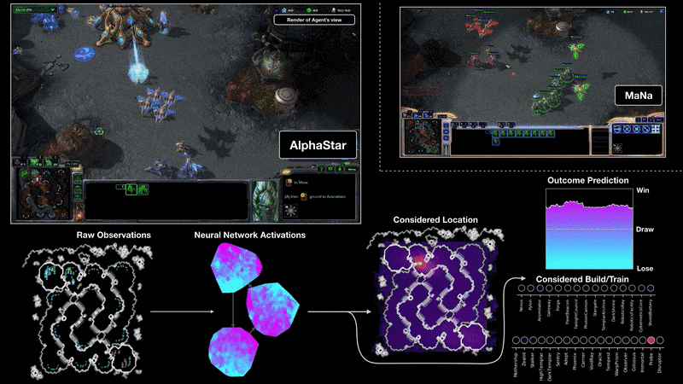
Deep Reinforcement Learning

Slide 21
Time for some Math

Slide 22

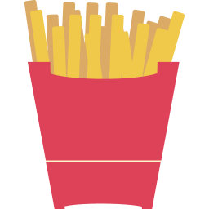

Fish and Chips
X 2
$12
X 1
X 1

Slide 23
Fish and Chips
X 2
$?
$?
$12
X 1
$?
X 1

Slide 24
Dataset
Fish | Chips | Sauce | Total
2 | 1 | 1 | $12
3 | 2 | 4 | $15
1 | 1 | 0 | $7
0 | 2 | 2 | $8
1 | 1 | 0 | $7

Slide 25
Linear Regression
X 2
$m₁
$m₂
+
$12
X 1
$m₃
X 1

Slide 26
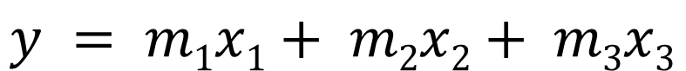

Linear Regression
x₁
$m₁
$m₂
$y
x₂
$m₃
x₃
$$y = m1x1+ m2x2+ m3x3$$

Slide 27
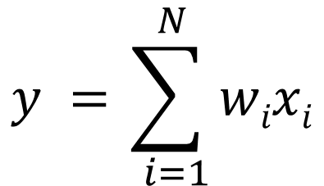
Linear Regression
x₁
w₁
w₂
y
x₂
w₃
x₃
$$y =\sum_{ i=1}^{ N}{wixi}$$

Slide 28
Fish and Chips
2
$3?
$10?
$27?
1
$7?
Error/Loss
1
$12

Slide 29
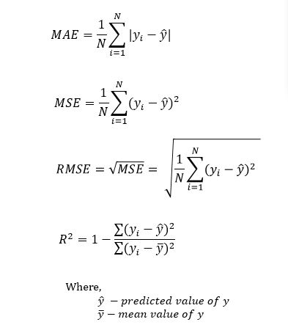
Loss Functions - Regression
$27?
Error/Loss
$12

Slide 30
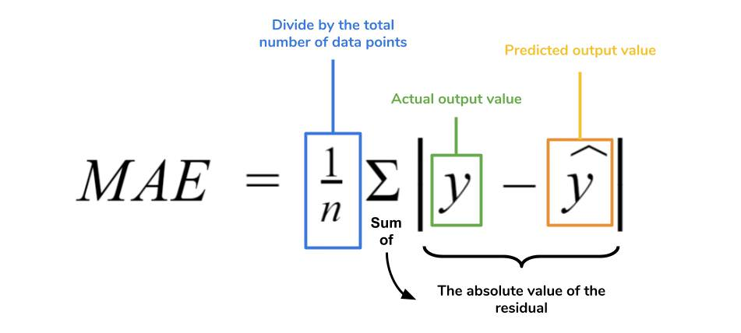
Error Metrics
$27?
Error/Loss
$12

Slide 31
Gradient descent
For each input feature and voting weight, adjust it up and down a bit and see how the error changes.
error
weight

Slide 32
Gradient descent
For each input feature and voting weight, adjust it up and down a bit and see how the error changes.
error
weight

Slide 33
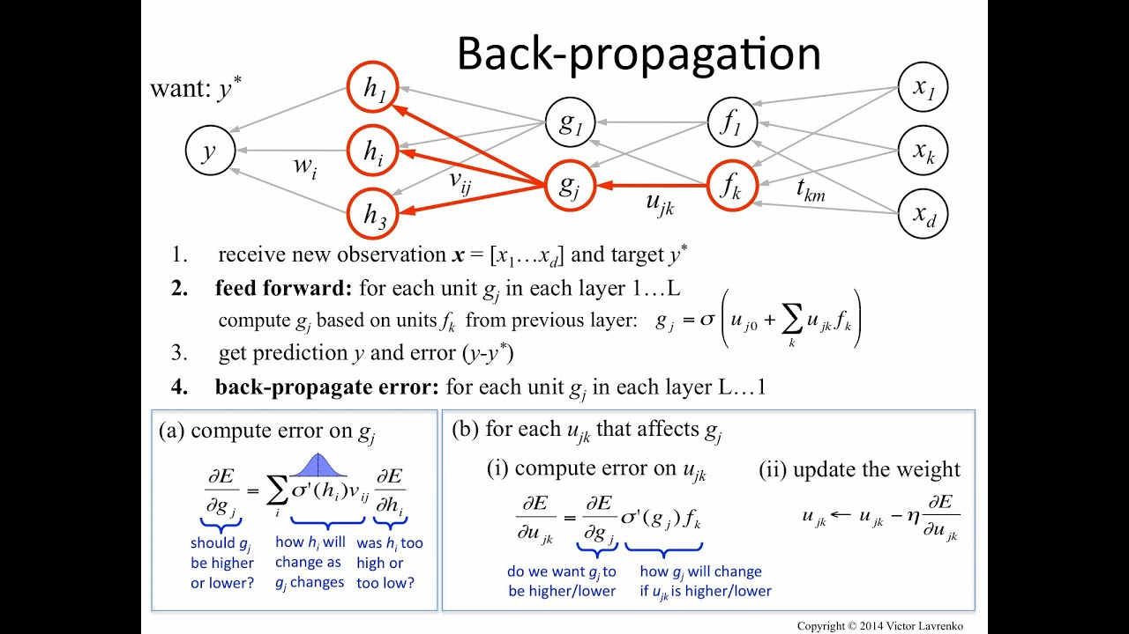
Gradient descent

Slide 34
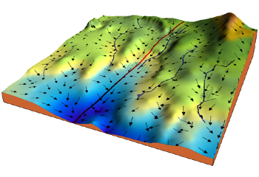
Gradient descent
error
weight

Slide 35
Weight Update
$$w^{new}=w^{old}+learning rate∗gradient$$
x₁
w₁
w₂
y
x₂
w₃
x₃

Slide 36
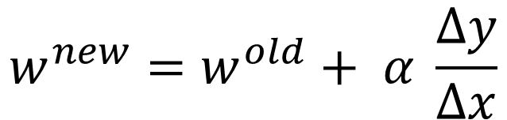
Weight Update
$$w^{new}=w^{old}+ α \frac{Δy}{Δx}$$
x₁
w₁
w₂
y
x₂
w₃
x₃

Slide 37

Learning Rate
error
error
error
w
w
w
Notes:
https://distill.pub/2017/momentum/

Slide 38

Learning Rate

Slide 39

Different Optimizers

Slide 40
Gradient descent
error
weight

Slide 41
Fish and Chips
2
$5?
$10?
$27?
1
$7?
Error/Loss
1
$12

Slide 42
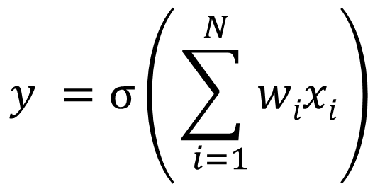


Neuron
x₁
w₁
w₂
x₂
$σ$
y
w₃
x₃
$$y =σ\left(\sum_{ i=1}^{ N}{wixi}\right)$$

Slide 43
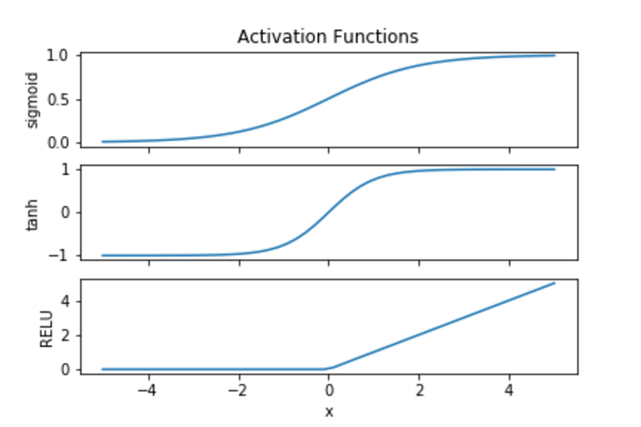
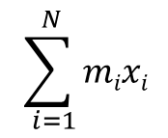
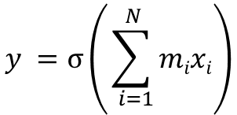
$$σ$$
$$y =σ\left(\sum_{ i=1}^{ N}{mixi}\right)$$
$$\sum_{ i=1}^{ N}{mixi}$$

Slide 44
Neuron
x₁
w₁
w₂
x₂
$σ$
y
w₃
x₃
$$y =σ\left(\sum_{ i=1}^{ N}{wixi}\right)$$

Slide 45
Neuron
x₁
w₁
w₂
x₂
$σ$
y
w₃
x₃

Slide 46
Neuron
x₁
x₂
y
x₃

Slide 47
Neural Network
x₁
x₂
y
x₃
Notes:
https://playground.tensorflow.org/

Slide 48
Neural Networks

Slide 49

Can only deal with numbers

Slide 50
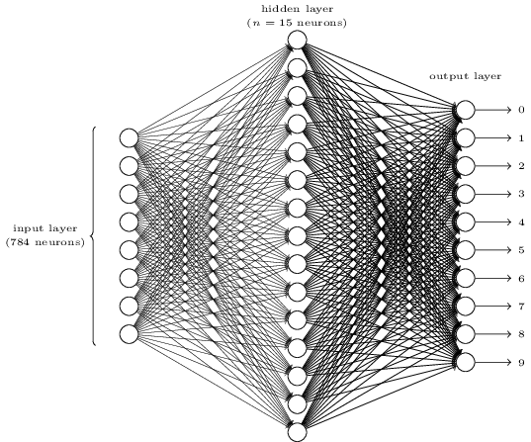
Let’s build a Neural Network

Slide 51
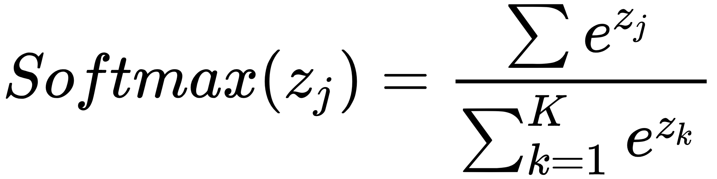
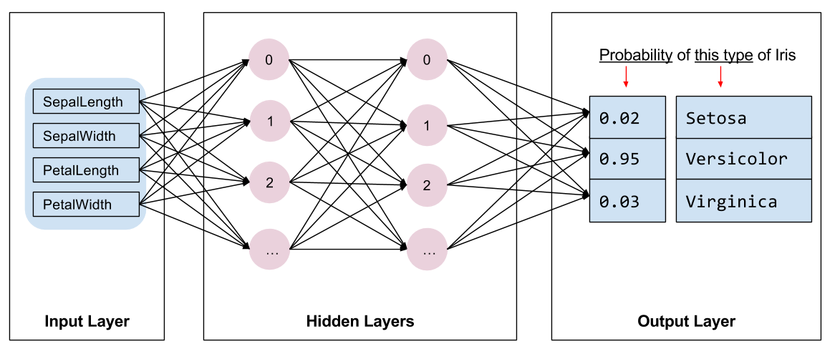
Softmax
Cross entropy
https://www.youtube.com/watch?v=ErfnhcEV1O8
Notes:
https://www.youtube.com/watch?v=ErfnhcEV1O8

Slide 52
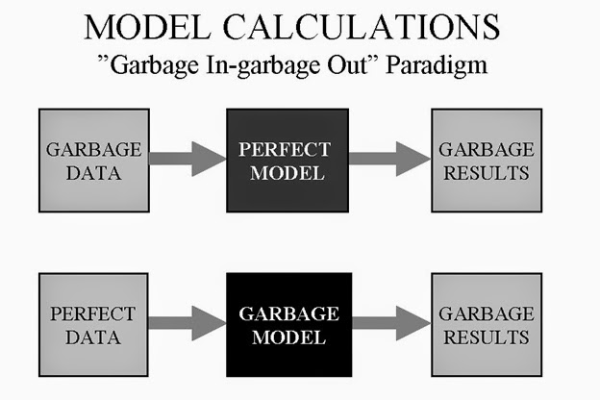
Training testing and validation
Training data
The data your algorithm will ‘learn’ from.
garbage in = garbage out.
Validation data
Data used to tune hyperparameters.
Results will be used to tweak the model.
Testing data
Used to validate final accuracy.
Should not be used for hyperparameter tuning.

Slide 53
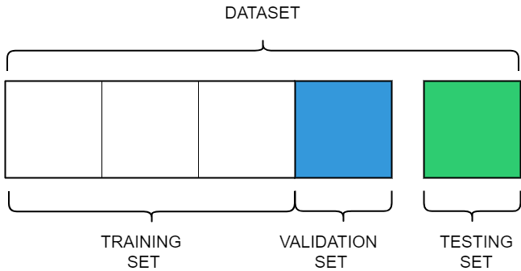
Data composition
Training/Test/Validation Split
Usually more training than testing examples.
Need a balance.
70/20/10 , 60/30/10, etc.
Risks in selecting the split
Overfitting, model generalizes too much on training data because of low number of examples.

Slide 54
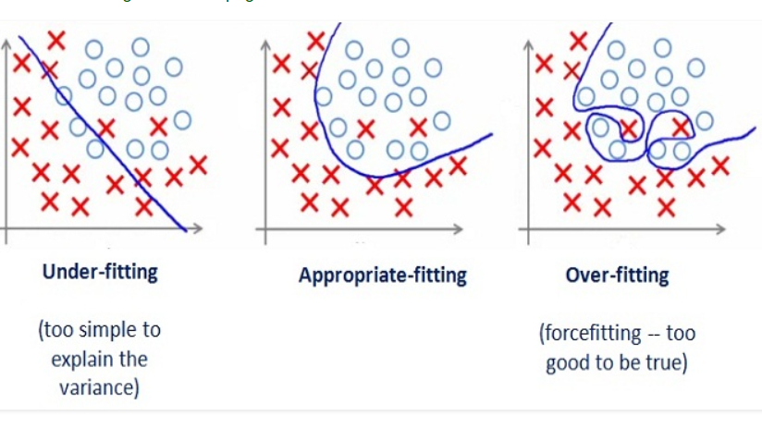
Overfitting/Underfitting

Slide 55
Overfitting

Slide 56
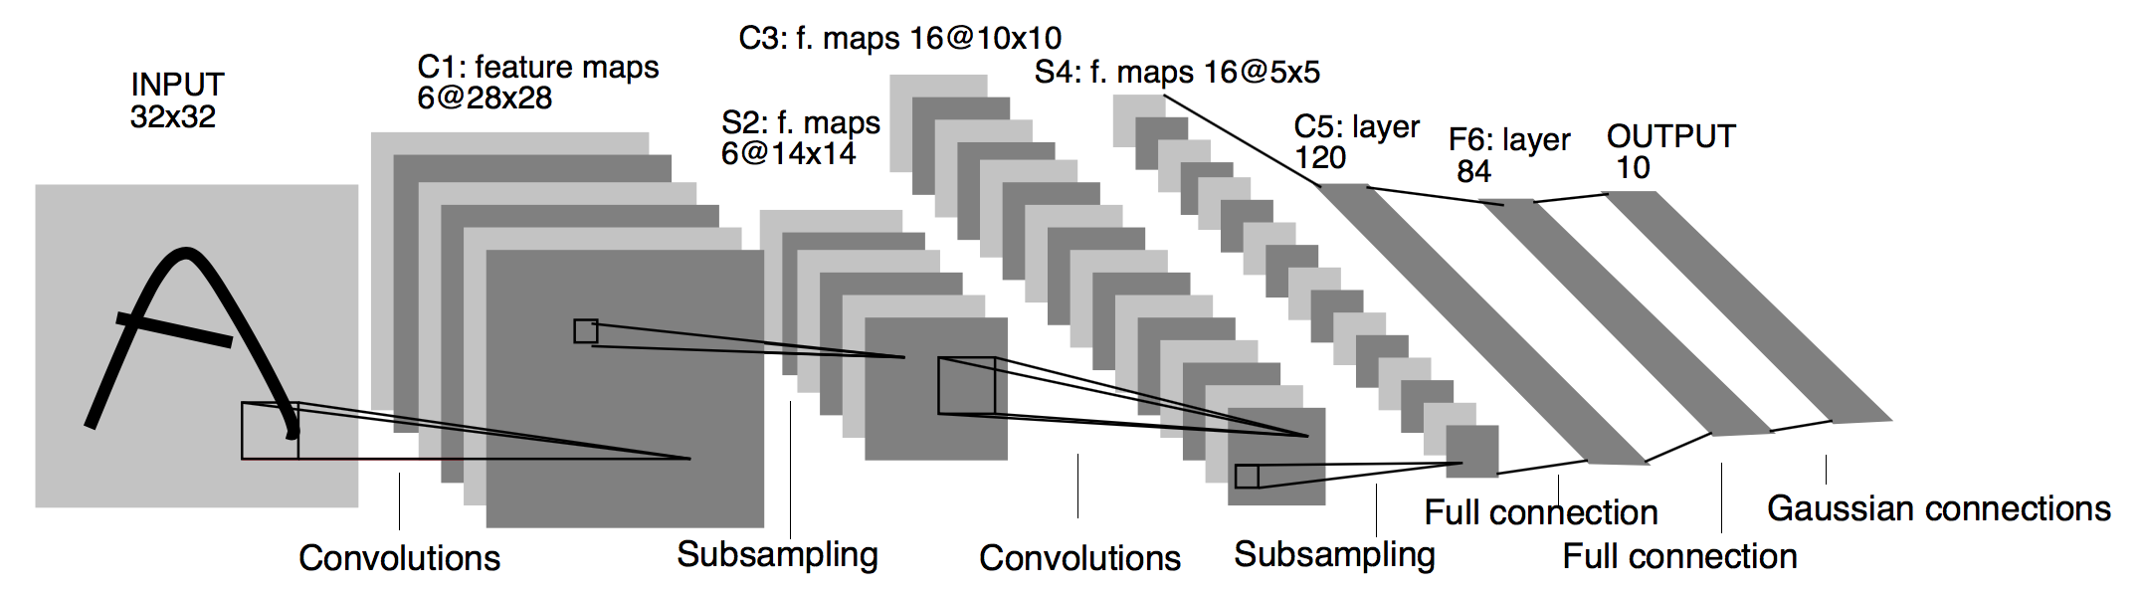

CNNs

Slide 57
CNN Architectures

Slide 58
CNN
Convolution
ReLU
Fully
connected
Fully
connected
Convolution
ReLU
Convolution
ReLU
Pooling
Pooling
8

Slide 59

CNN slides from:
Brandon Rohrer
@_brohrer_ on Twitter

Slide 60
A toy ConvNet: X’s and O’s
Says whether a picture is of an X or an O
A two-dimensional
array of pixels
CNN
X or O

Slide 61
For example
CNN
X
CNN
O

Slide 62
Trickier cases
CNN
X
translation
scaling
rotation
weight
CNN
O

Slide 63
Deciding is hard
?
=

Slide 64
What computers see
?
=

Slide 65
What computers see

Slide 66
Computers are literal
=
x

Slide 67
ConvNets match pieces of the image
=
=
=

Slide 68
Features match pieces of the image

Slide 74
Filtering: The math behind the match

Slide 75
Filtering: The math behind the match
Line up the feature and the image patch.
Multiply each image pixel by the corresponding feature pixel.
Add them up.
Divide by the total number of pixels in the feature.

Slide 76
Filtering: The math behind the match
1 x 1 = 1

Slide 77
Filtering: The math behind the match
1 x 1 = 1

Slide 78
Filtering: The math behind the match
-1 x -1 = 1

Slide 79
Filtering: The math behind the match
-1 x -1 = 1

Slide 80
Filtering: The math behind the match
-1 x -1 = 1

Slide 81
Filtering: The math behind the match
1 x 1 = 1

Slide 82
Filtering: The math behind the match
-1 x -1 = 1

Slide 83
Filtering: The math behind the match
-1 x -1 = 1

Slide 84
Filtering: The math behind the match
-1 x -1 = 1

Slide 85
Filtering: The math behind the match
1 x 1 = 1

Slide 86
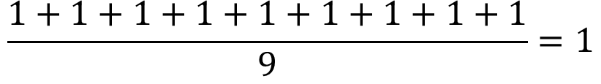
Filtering: The math behind the match
$$\frac{1+1+1+1+1+1+1+1+1}{9}=1$$

Slide 87
Filtering: The math behind the match
1 x 1 = 1

Slide 88
Filtering: The math behind the match
-1 x 1 = -1

Slide 89
Filtering: The math behind the match

Slide 90
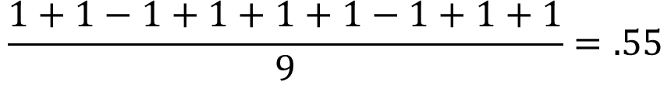
Filtering: The math behind the match
$$\frac{1+1−1+1+1+1−1+1+1}{9}=.55$$
.55

Slide 91
Convolution: Trying every possible match

Slide 92
Convolution: Trying every possible match
=

Slide 93
=
=
=

Slide 94
Convolution layer
One image becomes a stack of filtered images

Slide 95
Convolution layer
One image becomes a stack of filtered images

Slide 96
Pooling: Shrinking the image stack
Pick a window size (usually 2 or 3).
Pick a stride (usually 2).
Walk your window across your filtered images.
From each window, take the maximum value.

Slide 97
Pooling
maximum

Slide 98
Pooling
maximum

Slide 99
Pooling
maximum

Slide 100
Pooling
maximum

Slide 101
Pooling
maximum

Slide 102
Pooling
max pooling

Slide 104
Pooling layer
A stack of images becomes a stack of smaller images.

Slide 105
Normalization
Keep the math from breaking by tweaking each of the values just a bit.
Change everything negative to zero.

Slide 106
Rectified Linear Units (ReLUs)

Slide 107
Rectified Linear Units (ReLUs)

Slide 108
Rectified Linear Units (ReLUs)

Slide 109
Rectified Linear Units (ReLUs)

Slide 110
ReLU layer
A stack of images becomes a stack of images with no negative values.

Slide 111
Layers get stacked
The output of one becomes the input of the next.
Convolution
ReLU
Pooling

Slide 112
Deep stacking
Layers can be repeated several (or many) times.
Convolution
ReLU
Convolution
ReLU
Pooling
Convolution
ReLU
Pooling

Slide 113
Fully connected layer
Every value gets a vote

Slide 114
Fully connected layer
Vote depends on how strongly a value predicts X or O
X
O

Slide 115
Fully connected layer
Vote depends on how strongly a value predicts X or O
X
O

Slide 116
Fully connected layer
Future values vote on X or O
X
O

Slide 117
Fully connected layer
Future values vote on X or O
X
O

Slide 118
Fully connected layer
Future values vote on X or O
X
.92
O

Slide 119
Fully connected layer
Future values vote on X or O
X
.92
O

Slide 120
Fully connected layer
Future values vote on X or O
X
.92
O
.51

Slide 121
Fully connected layer
Future values vote on X or O
X
.92
O
.51

Slide 122
Fully connected layer
A list of feature values becomes a list of votes.
X
O

Slide 123
Fully connected layer
These can also be stacked.
X
O

Slide 124
Putting it all together
A set of pixels becomes a set of votes.
.92
X
Convolution
ReLU
Fully
connected
Fully
connected
Convolution
ReLU
Convolution
ReLU
Pooling
Pooling
O
.51

Slide 125
Learning
Q: Where do all the magic numbers come from?
Features in convolutional layers
Voting weights in fully connected layers
A: Backpropagation

Slide 126
Backprop
Error = right answer – actual answer
.92
X
Convolution
ReLU
Fully
connected
Fully
connected
Convolution
ReLU
Convolution
ReLU
Pooling
Pooling
O
.51

Slide 127
Backprop
.92
X
Convolution
ReLU
Fully
connected
Fully
connected
Convolution
ReLU
Convolution
ReLU
Pooling
Pooling
O
.51

Slide 128
Backprop
.92
X
Convolution
ReLU
Fully
connected
Fully
connected
Convolution
ReLU
Convolution
ReLU
Pooling
Pooling
O
.51

Slide 129
Backprop
.92
X
Convolution
ReLU
Fully
connected
Fully
connected
Convolution
ReLU
Convolution
ReLU
Pooling
Pooling
O
.51

Slide 130
Backprop
.92
X
Convolution
ReLU
Fully
connected
Fully
connected
Convolution
ReLU
Convolution
ReLU
Pooling
Pooling
O
.51

Slide 131
Backprop
.92
X
Convolution
ReLU
Fully
connected
Fully
connected
Convolution
ReLU
Convolution
ReLU
Pooling
Pooling
O
.51

Slide 132
Gradient descent
For each input feature and voting weight, adjust it up and down a bit and see how the error changes.
error
weight

Slide 133
CNN slides from:
Brandon Rohrer
@_brohrer_ on Twitter
#HowItWorks #ConvNet
brohrer@microsoft.com

Slide 134
Difficulties with real data
Data hungry
Garbage in = Garbage out
Need to monitor training data quality
Overfitting
Bias
Notes:
To be effective, machine learning has a significant requirement: data. Lots of data. We can expect a child to understand what a cat is and identify other cats after just a few encounters or by being shown a few examples of cats, but ML algorithms require many, many more examples. Unlike humans, these algorithms can't easily develop inferences on their own. For example, machine learning algorithms interpret a picture of a cat against a grassy background differently than a cat shown in front of a fireplace
The algorithms also need a lot of data to separate the relevant "features" of the cat from the background noise. It is the same for other noise such as lighting and weather. The algorithms also need to identify meaningful features that distinguish the cat itself. Variations that humans do not need extra data to understand -- such as a cat's color or size -- are difficult for machine learning.
Two common problems caused by poor data curation are overfitting and bias. Overfitting is the result of a training data set that does not adequately represent the actual variance of production data; it therefore produces output that can only deal with a portion of the entire data stream.
Bias is a deeper problem that relates to the same root cause as overfitting but is harder to identify and understand. Biased data sets are not representative, have skewed distribution, or do not contain the correct data in the first place. This biased training data results in biased output that makes incorrect conclusions that may be difficult to identify as incorrect. Although there is significant optimism about machine learning applications, data quality problems should be a major concern

Slide 135
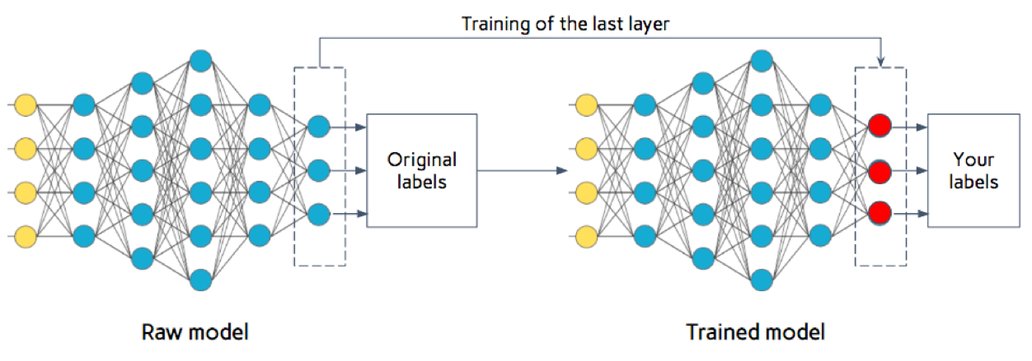
Fine Tuning – dealing with small data

Slide 136
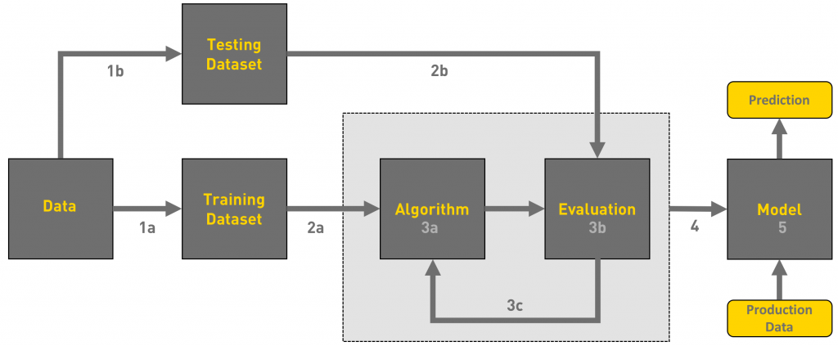
ML Workflow

Slide 137
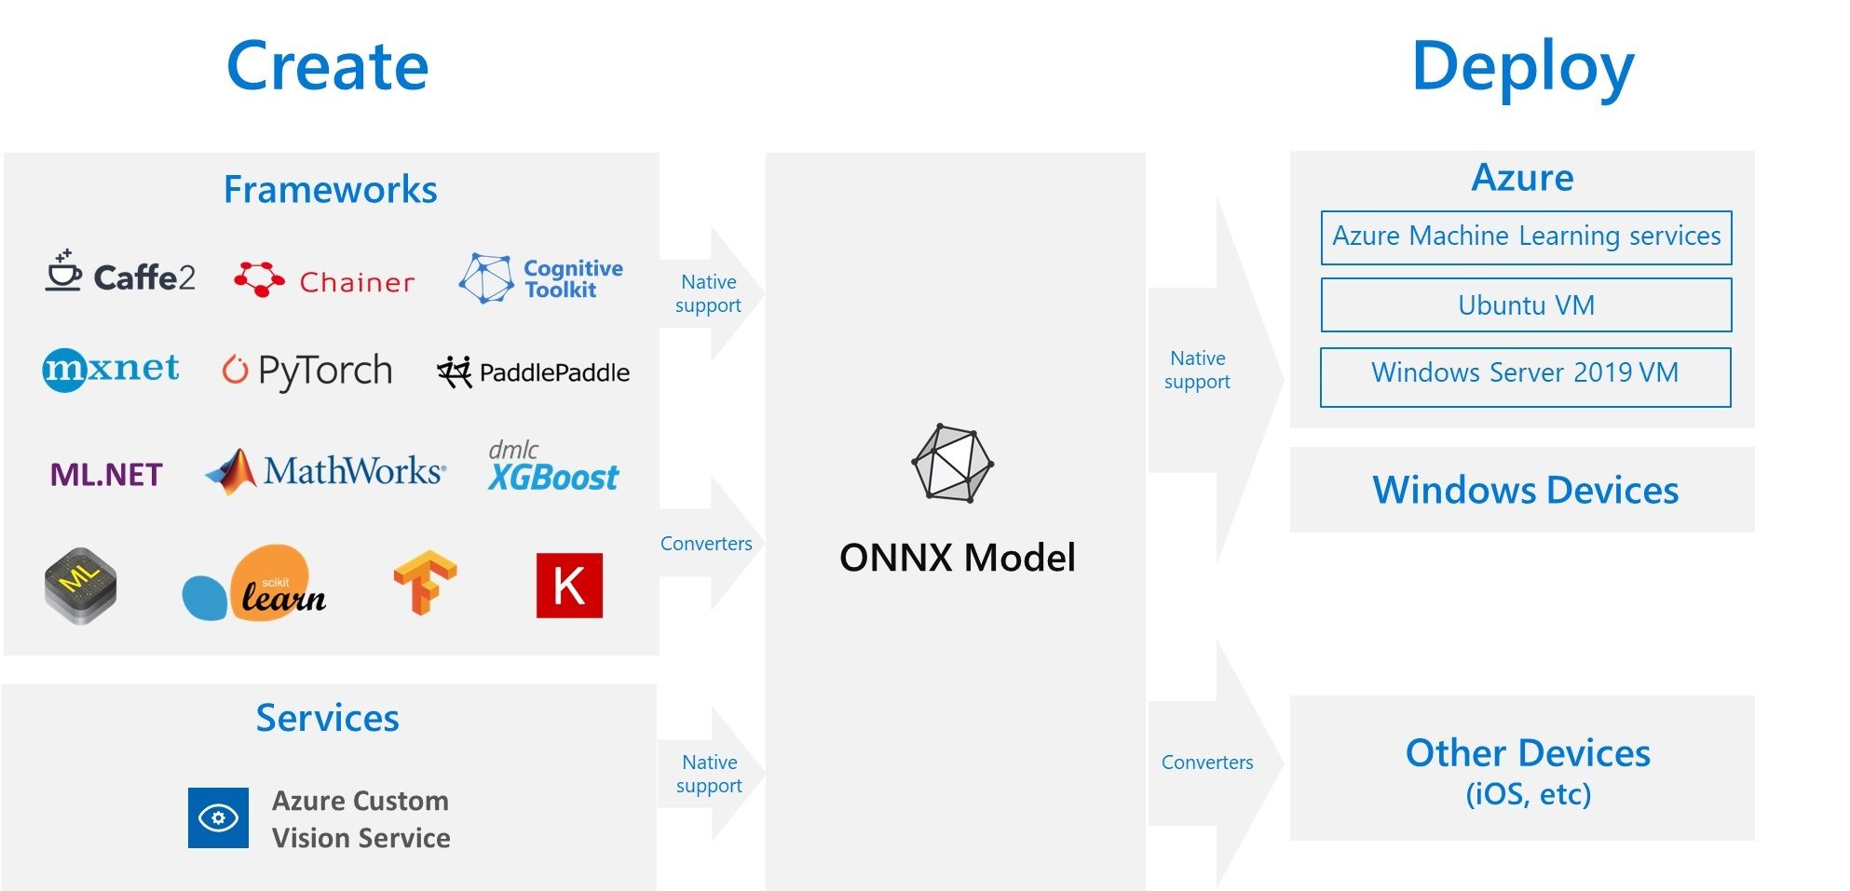
Cloud Architecture
Notes:
Just give an overview over how this thing works
U can say there are other ways of doing this like containerization

Slide 138
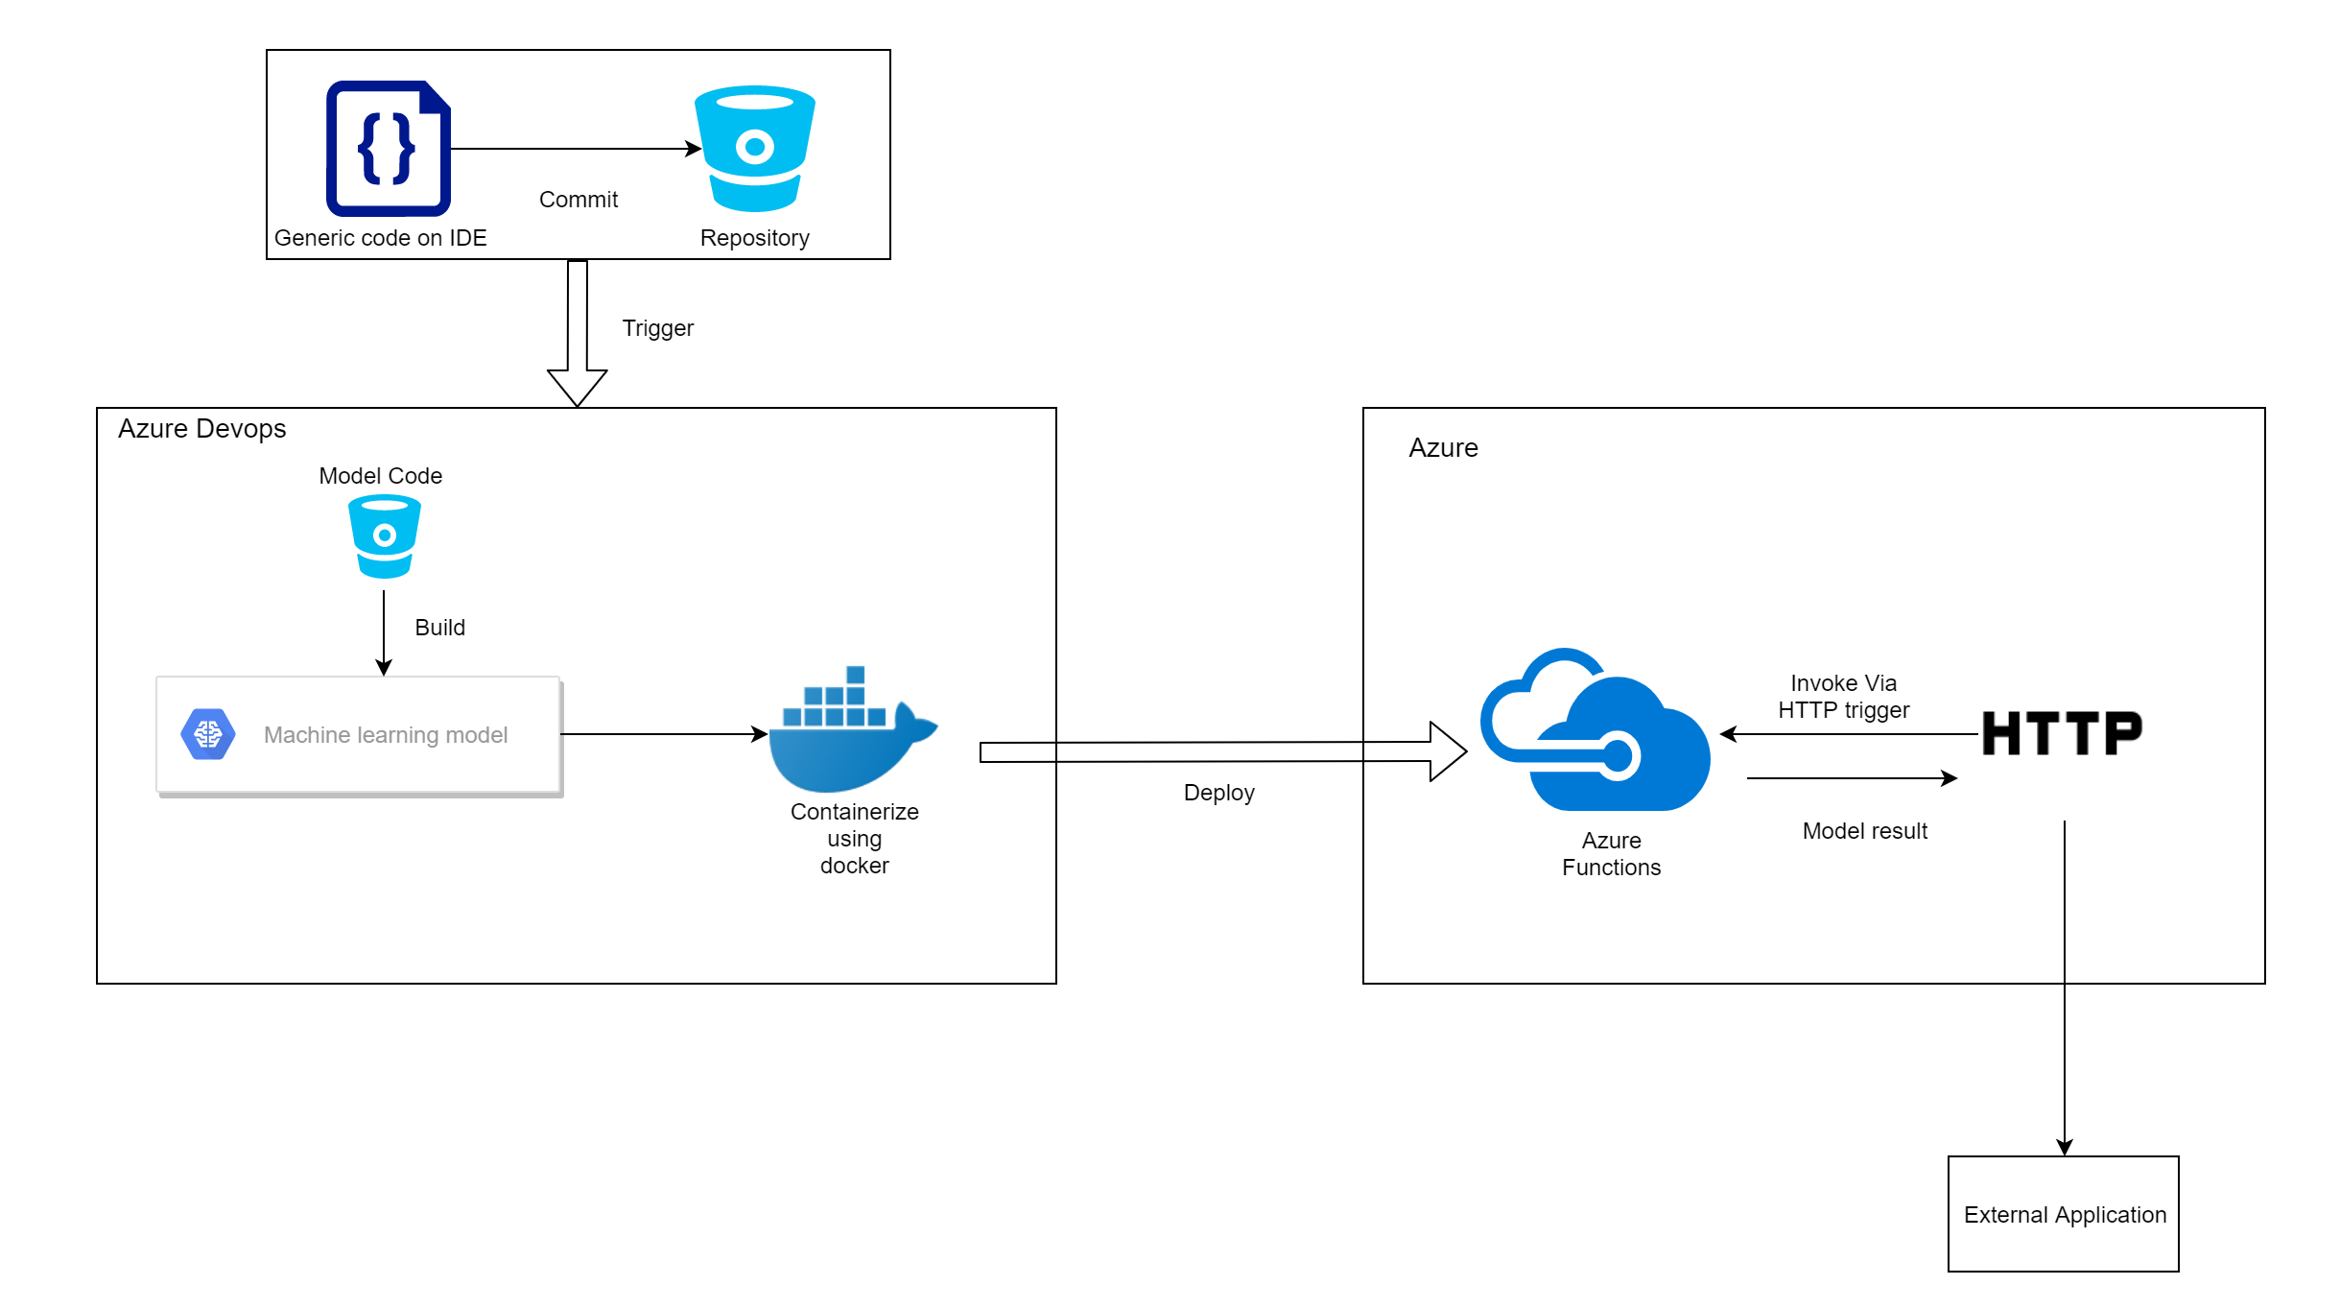
Alternative Cloud Architecture

Slide 139
Examples
Process Automation
Data entry, Insurance Risk Assessment
Sales Optimisation
Sales forecasting, churn predictions
Customer Service
Chatbots, VA
Security and Fraud
Predict Analytics vs Behavioural Analytics
Notes:
1. Process Automation
Intelligent process automation (IPA) combines artificial intelligence and automation. From automating manual data entry, to more complex use cases like automating insurance risk assessments. ML is suited for any scenario where human decision is used, but within set constraints, boundaries or patterns. Thanks to cognitive technology like natural language processing, machine vision and deep learning, machines can augment traditional rule-based automation and overtime learn to do them better as it adapts to change
2. Sales Optimization
Sales typically generates a lot of unstructured data that can ideally be used to train machine learning algorithms
Used for customer sentiment analysis, sales forecasting analysis, and customer churn predictions. With these solutions, sales managers are alerted in advance to specific deals or customers that are risk.
3. Customer Service
Due to the high volume of customer interactions, the massive amounts of data captured and analyzed, it is the ideal teaching material required to fine tune ML algorithms. Artificial intelligence agents are now capable of recognizing a customer query and suggesting the appropriate article for a swift resolution. Thus freeing up human agents to focus on more complex issues, subsequently improving the efficiency and speed of decisions.
4. Security
Machine learning can help enterprises improve their threat analysis and how they respond to attacks and security incidents.
Predictive analytics enables the early detection of infections and threats, while behavioral analytics ensures that any anomalies within the system does not go unnoticed

Slide 140
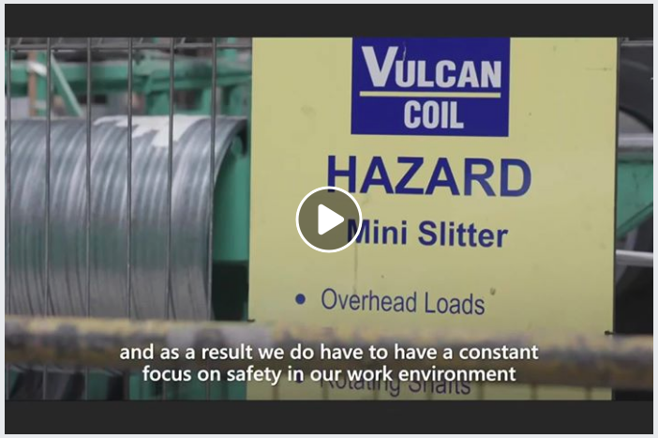
https://www.facebook.com/datacomcommunity/videos/10155630315030847/
Notes:
Can either click the video or the link

Slide 141
Resources
Youtube
http://3b1b.co/neural-networks
https://www.youtube.com/playlist?list=PLZbbT5o_s2xq7LwI2y8_QtvuXZedL6tQU
https://www.youtube.com/watch?v=JB8T_zN7ZC0
… + a LOT more
MOOCs
fast.ai
deeplearning.ai
http://cs231n.stanford.edu
Tensorflow Transfer Learning tutorial
https://www.tensorflow.org/beta/tutorials/images/transfer_learning

Slide 142
Resources
Azure Functions
https://azure.microsoft.com/en-us/resources/videos/ignite-2018-machine-learning-using-python-in-azure-functions/
https://azure.microsoft.com/en-au/resources/samples/functions-python-tensorflow-tutorial/

Slide 143
https://notebooks.azure.com/rivindu/projects/msa-phase2

